Slide 1
Automated Early Detection of Plant Diseases using Optimized Deep Learning Techniques
Paper id:130
Dr. G. Kavitha, Dr. P. Latchoumy, Mr. Noorul Hassan M.U
Department of Information Technology,
B.S.A Crescent Institute of Science and Technology,
Vandalur, Chennai, Tamilnadu, India

Slide 2
Abstract
Agriculture plays a important role in food security and supports the global economy.
Plant diseases reduce yield significantly. Early detection is the key to minimizing losses.
We use CNNs to extract meaningful features from plant leaf images for early-stage disease prediction.
A novel Region Proposal Network with Self-Attention (RPN-SA) is proposed for high-accuracy localization of affected regions.
GLCM texture features and bounding box regression are used to enhance classification accuracy up to 98%.

Slide 3
Introduction
Agriculture plays a important role in food security, the global economy and faces multiple threats: pests, climate change, and diseases.
About 30% of crops are lost due to plant diseases globally. So, early automated diagnosis reduces chemical use and improves yield.
Deep learning and computer vision can identify subtle, early signs of diseases from leaf images.
Our method proposes a specialized model to focus on small disease regions for better diagnosis.

Slide 4
Research Objectives
Develop a framework to detect plant diseases efficient and accurately.
Focus only on infected regions using smart Region Proposals.
Improve feature extraction using GLCM to capture fine texture details.
Prioritize infected areas using self-attention for accurate bounding boxes.
Use SVM for final classification to handle small and imbalanced data.

Slide 5
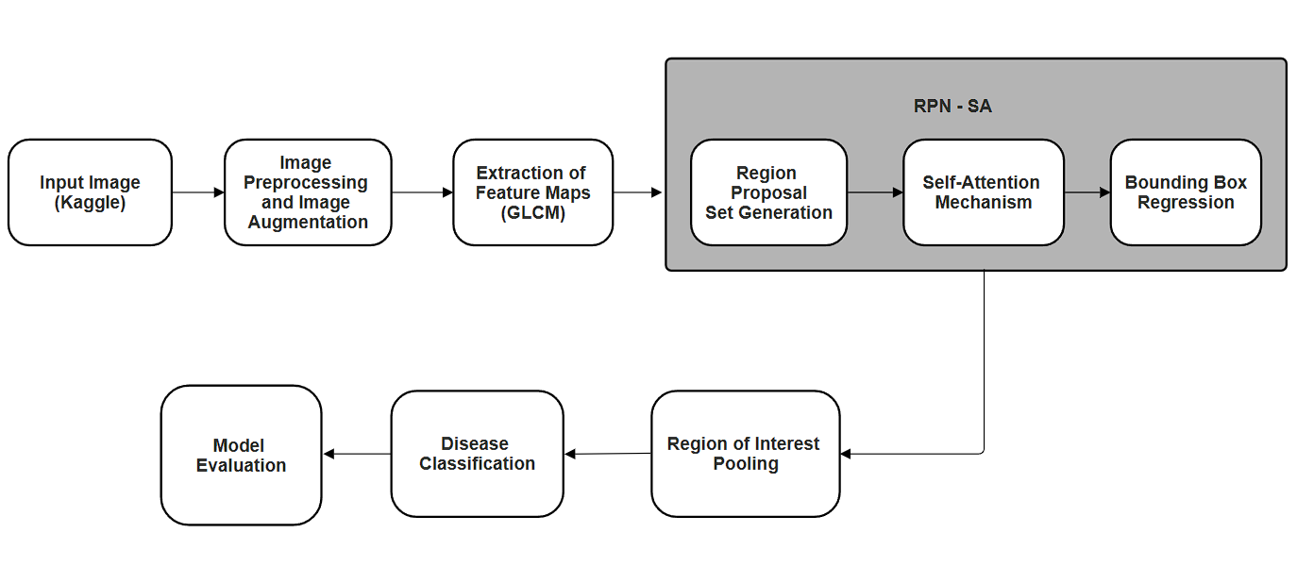
Architecture of RPN-SA

Slide 6
Proposed Methodology
Image Preprocessing & Augmentation
GLCM Feature Extraction
Region Proposal Network with Self-Attention
Bounding Box Regression
ROI Pooling & Classification

Slide 7
Preprocessing & Augmentation
Resizing : 512×512
Normalization: Pixel values [0,1] range
Rotate: ±10° (p=0.5)
Shift: Horizontal/vertical shift ±10% (p=0.5)
Horizontal Flip: 50% chance
Helps reduce overfitting, especially with limited data.

Slide 8
GLCM Feature Extraction
GLCM: Gray-Level Co-occurrence Matrix captures pixel relationships.
Extracts texture descriptors like contrast, correlation, and homogeneity.
Enhances edge and surface patterns of diseased regions.
GLCM features help detect minute early-stage symptoms
Output, then feature maps passed to the classification stages.

Slide 9
RPN with Self-Attention
RPN slides over feature maps to generate anchor boxes.
Self-attention highlights major infected areas and ignore background.
Compares spatial features to identify disease-specific patterns.
Makes the system efficient by reducing irrelevant region checks.
Outputs a ranked set of candidate disease regions.

Slide 10
Bounding Box Regression
Modifies bounding box coordinates around disease areas.
Reduces overlap and improves tightness of detection boxes.
Optimizes region size, scale, and location for accuracy.
Works in cycle with self-attention to enhance visual focus.
Ensures minimal false positives around leaf veins or background.

Slide 11
ROI Pooling & Classification
Applies Region of Interest (ROI) Pooling to standardize feature map sizes.
Converts variable-sized disease regions to fixed (e.g., 7×7).
Uses max-pooling to preserve dominant features within ROIs.
SVM classifier predicts disease presence (binary classification).
Outputs “diseased” or “healthy” label for each detected ROI.

Slide 12
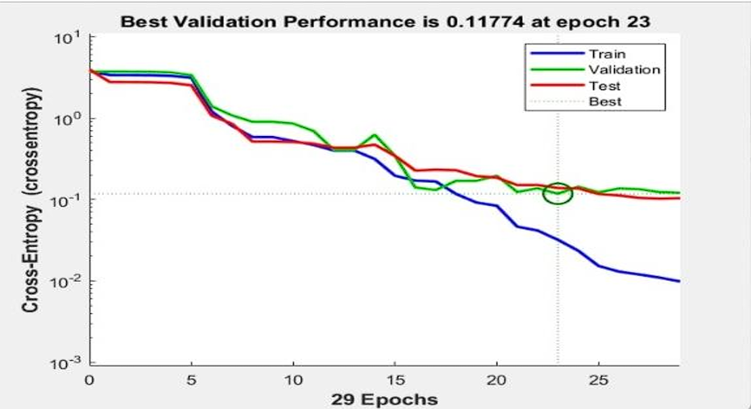
Results & Findings
Cross-entropy loss
Cross-entropy loss was used to track training quality—lower values indicate better performance.
The best validation loss was 0.11774, achieved at epoch 23.
The graph shows a consistent drop in loss across training, validation, and test sets.
This indicates the model has learned the patterns effectively and avoids overfitting.

Slide 13
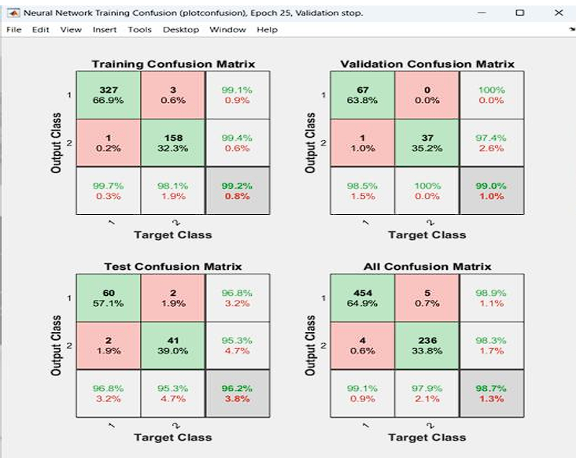
Results & Findings
Confusion matrices
Confusion matrices (Train, Val, Test, Overall) show high true positive rates across all classes.
Diagonal elements show correctly predicted cases, while off-diagonals show misclassifications.
Test confusion matrix shows:
Class 1 (Diseased): 96.8% accuracy
Class 2 (Healthy): 95.3% accuracy
Overall : 98.7% accuracy

Slide 14
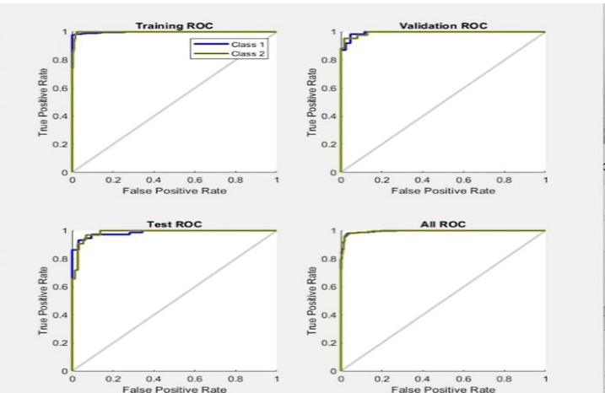
Results & Findings
ROC Curve Analysis
ROC curves show performance for both disease and healthy categories.
The curve approaches the top-left corner, indicating high sensitivity and specificity.
AUC (Area Under Curve) values are close to 1.0 in all sets—Train, Val, Test.
The RPN-SA model is highly reliable in distinguishing diseased vs. healthy leaves.

Slide 15
Conclusion
The proposed RPN-SA model effectively detects plant diseases at early stages with high accuracy.
Experimental results show superior performance, achieving an overall accuracy of 98.7%, minimizing misclassifications.
Confusion matrices and ROC curves confirm strong predictive capability across train, validation, and test phases.
This model supports timely intervention in agriculture, ensuring better yield and reduced crop loss.

Slide 16
References
[1] Y. Dong et al., "Automatic System for Crop Pest and Disease Dynamic Monitoring and Early Forecasting," in IEEE Journal of Selected Topics in Applied Earth Observations and Remote Sensing, vol. 13, pp. 4410-4418, 2020, doi: 10.1109/JSTARS.2020.3013340.
[2] R. Rakholia, J.Tailor, M. Prajapati, M. Shah, J. R. Saini, “Emerging Technology Adoption for Sustainable Agriculture in India– a Pilot Study”, Journal of Agriculture and Research, Vol.17, https://doi.org/10.1016/j.jafr.2024.101238.
[3] W. Shafik, A. Tufail, A. Namoun, L. C. De Silva and R. A. A. H. M. Apong, "A Systematic Literature Review on Plant Disease Detection: Motivations, Classification Techniques, Datasets, Challenges, and Future Trends," in IEEE Access, vol. 11, pp. 59174-59203, 2023, doi: 10.1109/ACCESS.2023.3284760
[4] A. Picon, A. Alvarez-Gila, M.Seitz, A.Ortiz-Barredo, J. Echazarra, A. Johannes, “Deep convolutional neural networks for mobile capture device-based crop disease classification in the wild”, Computers and Electronics in Agriculture, Vol.161, pp: 280 290, 2019, ISSN 0168-1699, https://doi.org/10.1016/j.compag.2018.04.002.

Slide 17
References
[5] Krishna MS, Machado P, Otuka RI, Yahaya SW, Neves dos Santos F, Ihianle IK, “Plant Leaf Disease Detection Using Deep Learning: A Multi-Dataset Approach”, J Multidisciplinary Scientific Journal, Vol. 8, No.1, pp: 1-24,2025, https://doi.org/10.3390/j8010004 .
[6] Loey, M., ElSawy, A., & Afify, M., “Deep Learning in Plant Diseases Detection for Agricultural Crops: A Survey”, International Journal of Service Science, Management, Engineering, and Technology, Vol. 11, No.2, pp:41-58, 2020, https://doi.org/10.4018/IJSSMET.202004010
[7] Md. Ashiqul Islam, Md. Nymur Rahman Shuvo, Muhammad Shamsojjaman, Shazid Hasan, Md. Shahadat Hossain and Tania Khatun, “An Automated Convolutional Neural Network Based Approach for Paddy Leaf Disease Detection,” International Journal of Advanced Computer Science and Applications, Vol. 12, No. 1, 2021, http://dx.doi.org/10.14569/IJACSA.2021.0120134
[8] L. Li, S. Zhang and B. Wang, "Plant Disease Detection and Classification by Deep Learning—A Review," IEEE Access, vol. 9, pp. 56683-56698, April 2021, doi: 10.1109/ACCESS.2021.3069646..

Slide 18
Thank You

